Slide 1
Cognition Fundamentals: Decision-making & Actions
How do we learn from our perceptions?
Responsible Lecturer: Bram Heijligers

Slide 2
What we learn and why
Learning Objectives
Sample relevant real-world input required for situational awareness & reinforcement learning.
Sample cognitive processes used to process relevant real-world input required for situational awareness & reinforcement learning.
Using situational awareness & reinforcement learning to respond.
→ feeds into our reinforcement learning algorithm & symbolic AI and helps to optimize it
→ how we process input and take appropriate action on it
→ how we execute the bin-picking task

Slide 3
What is situational awareness?

Slide 4
How do I achieve situational awareness
What input do we need to understand a given situation?
Conceptual understanding of the individual element of the environment
Prior-knowledge of individual elements which situation
Causal relationships between the individual elements

Slide 5
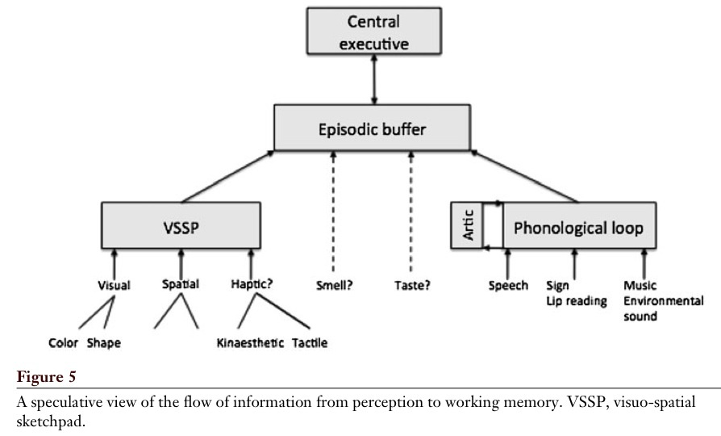
Working Memory
Baddeley, 2012

Slide 6
Central executive
Most important component of WM
Has limited capacity, deals with demanding cognitive tasks, resembles attention
Is related to executive processes (processes that organize and coordinate the functioning of the cognitive system to achieve current goals)
Baddeley (1996 – cf. Miyake et al.):
- focusing attention or concentration
- dividing attention between two stimulus streams
- switching attention between tasks
- interfacing with long-term memory

Slide 7
LTM: Familiarity vs. Recollection
Familiarity – observer knowing an item is old or new, without having specific details associated with that memory; the process of recognizing an item on the basis of its perceived memory strength but without retrieval of any specific details about the study episode
Recollection – observer accessing specific details about a previously experienced item

Slide 8
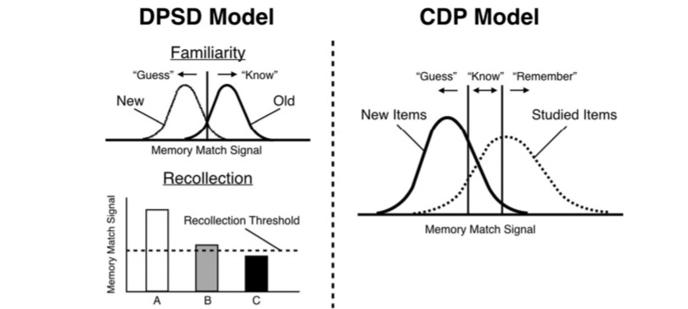
Familiarity vs. Recollection: The DPSD and CDP Models
Notes:
DPSD = dual-process signal-detection
CDP = continuous dual process

Slide 9
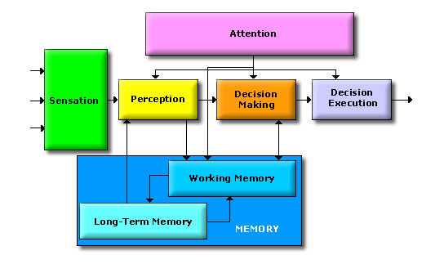
What is a decision?
Dependent on situational awareness
Dependent on the (un)certainty of the environment and processes within
Dependent on agent motivation

Slide 10
How do we make decisions?

Slide 11


Slide 12


Rewards & Motivation
Motivation is what motivates us; lies at the base of intelligence
Reinforcement Learning is learning what to do and how to map situations to actions. The end result is to maximize the numerical reward signal. The learner is not told which action to take, but instead must discover which action will yield the maximum reward.

Slide 13
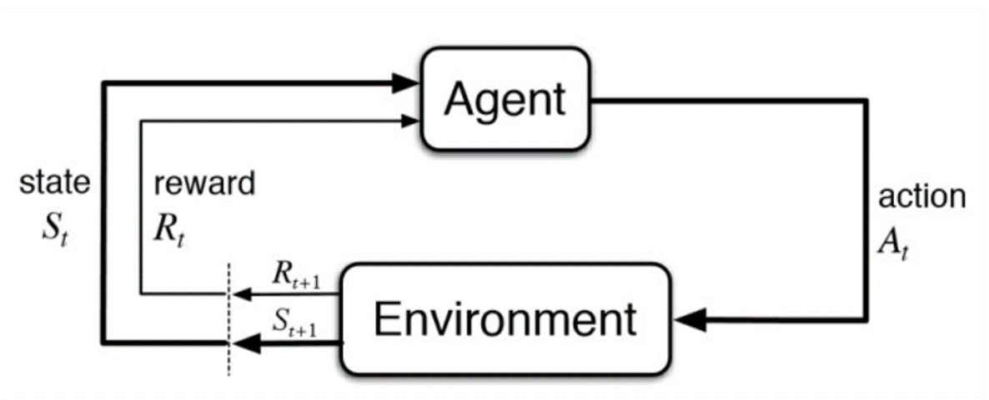
Reinforcement Learning
What happens in our cognitive and robotics model is located inside the agent bubble. Question now is; would it also be valuable to work out the environment for our flowchart?

Slide 14
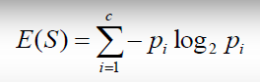
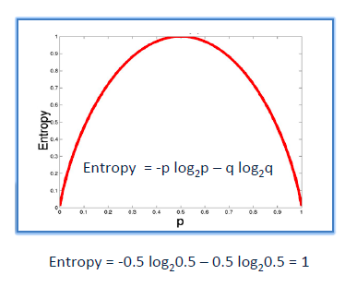
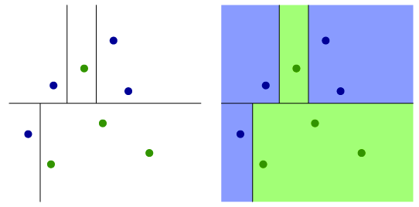
Information gain/Reduction of Uncertainty
It is like playing “20 questions”
ENTROPY = measure of disorder of a system
Zero entropy ~ completely homogeneous sample
Entropy = 1 ~ the sample is equally divided
ENTROPY

Slide 15
What action to take?
Now that we have established how we make a decision in a geiven situation, we can start taking actions to reach our goal

